Slide 1
Welcome
To
Project - 8
Dynamic Workforce Insights and Recommendation Platform
Name – Mohd Jubair Khan
Date – 12 – 12 - 2024

Slide 2
Abstract
This project aims to harness the power of data analytics to forecast future trends in the job market, helping job seekers and recruiters make informed decisions. By analyzing historical and current job posting data, the platform identifies key job categories, demand patterns, and salary trends.
The predictive model developed in this project uses machine learning and time-series analysis to forecast job market dynamics, such as high-demand roles, emerging sectors, and geographic wage disparities. The deliverables include detailed forecasts, a recommendation system, and actionable insights for adapting to evolving workforce needs.
Visualizations and predictive analytics provide clarity on future workforce trends, empowering job seekers to align their skills with market demand, and enabling employers to understand workforce shifts.

Slide 3
Content
1. Introduction
2. Objectives
3. Methods
4. Results
5. Conclusions
Chapter - 1
1. Introduction
The global job market is constantly evolving, influenced by economic, technological, and societal changes. As these shifts occur, it becomes crucial for job seekers and recruiters to stay ahead of emerging trends, high-demand roles, and changing salary structures. However, understanding these trends can be challenging due to the vast amount of data generated by job postings across industries.
This project aims to bridge this gap by utilizing data analytics to provide actionable insights into workforce trends. By analyzing historical and real-time job posting data, we aim to uncover key patterns such as:
High-Demand Job Roles: Identifying roles in growing sectors
Salary Trends: Understanding wage shifts across regions.
Emerging Job Categories: Highlighting new and evolving roles.
Geographic Insights: Comparing job market trends across different locations.

Slide 4
Using advanced analytics and predictive modeling, this platform empowers job seekers with tailored recommendations, helping them make data-driven decisions for their career growth. Recruiters can also benefit by identifying trends to adjust their hiring strategies effectively.
Analyzing Job Trends: By studying historical job posting data, the project uncovers patterns in the demand for different job roles. This helps identify high-growth sectors and job categories that are expected to see increased demand in the future.
Understanding Salary Trends: Salary structures vary across different roles, regions, and time periods. This analysis highlights wage trends, including regional differences in compensation, enabling job seekers to make strategic career decisions based on potential earning power.
Predicting Emerging Job Categories: New job categories are continually emerging, driven by technological advancements and shifts in industry needs. By analyzing the frequency of job postings, this project predicts which job categories are on the rise and will likely dominate the future job market.
Geographic Insights: The job market is not uniform across regions. By comparing salary trends and job demands across different geographic locations, this project helps both job seekers and recruiters understand regional wage disparities and tailor their strategies accordingly.

Slide 5
Chapter - 2
2. Objectives:
1. Identify High-Demand Job Roles
Analyze historical job posting data to uncover job roles that are in high demand across various industries.
Predict future demand for these roles based on emerging trends and industry shifts.
2. Analyze Salary Trends
Examine salary data (hourly rates, budgets, etc.) to understand compensation patterns for different job titles.
Identify geographic wage disparities and provide insights into salary trends over time.
3. Discover Emerging Job Categories
Analyze job posting frequencies to identify new and growing job categories.
Forecast future trends in job categories and sectors that are expected to experience significant growth.
4. Provide Predictive Insights on Job Market Dynamics
Develop predictive models to anticipate changes in job market trends, such as shifts in job demand, salary structures, and industry growth.
Use time-series analysis and machine learning models to predict the future workforce landscape.

Slide 6
5. Build a Personalized Job Recommendation System
Create a recommendation engine that tailors job suggestions to individual profiles based on career preferences, skills, and market trends.
Integrate the system with job seeker data to provide actionable insights for career growth.
6. Visualize Workforce Trends and Insights
Design interactive visualizations (charts, maps, and dashboards) to present key findings, such as emerging job categories, salary distributions, and geographic trends.
Provide clear, actionable visual insights that guide job seekers and recruiters in making informed decisions.
7. Track Remote Work Trends
Analyze the growth of remote work and predict future trends based on job postings.
Provide insights into the shift towards remote work and its implications for job seekers and employers.
8. Develop a Job Market Dynamics Dashboard
Create a dynamic dashboard (using platforms like Streamlit) that monitors job market trends in real-time, with regular updates on job postings, salary trends, and emerging roles.
Allow stakeholders (job seekers, employers, policymakers) to interact with and explore key job market metrics and insights.

Slide 7
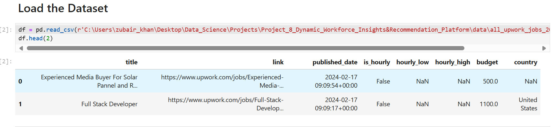
Chapter - 3
3. Methods:
(i). Data Collection and Preprocessing:
* Data Gathering: Collect historical and real-time job posting data from multiple sources such as job boards, recruitment platforms, and industry reports.

Slide 8
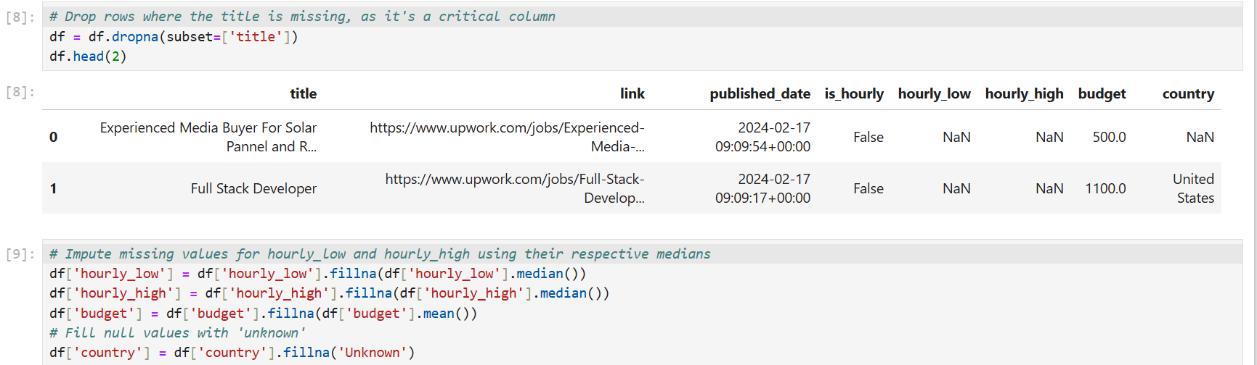
* Data Cleaning: Handle missing values, remove duplicates, and ensure the consistency of data types for columns like salary ranges, job titles, and geographical information.

Slide 9
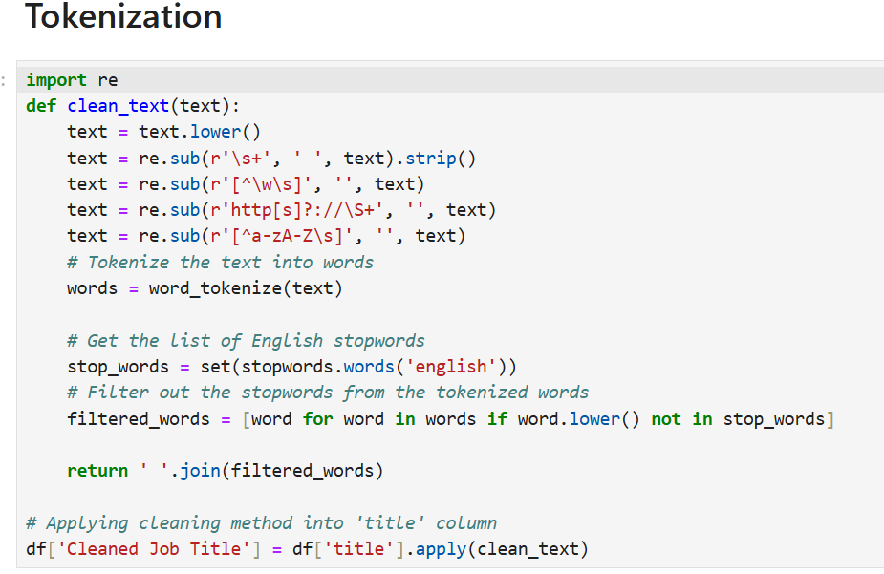
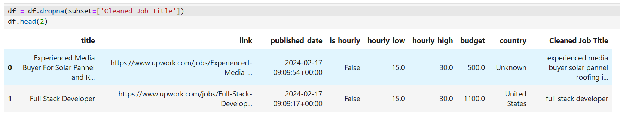
* Feature Engineering: Create new features based on existing data to better represent job market dynamics (e.g., job title keywords, job category identifiers, and salary ranges).

Slide 10
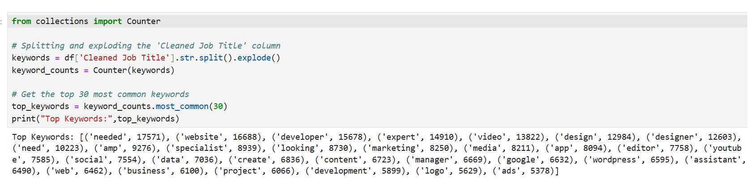
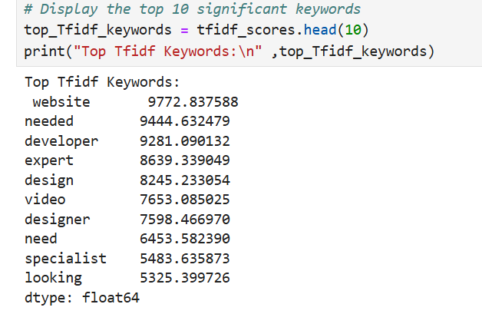
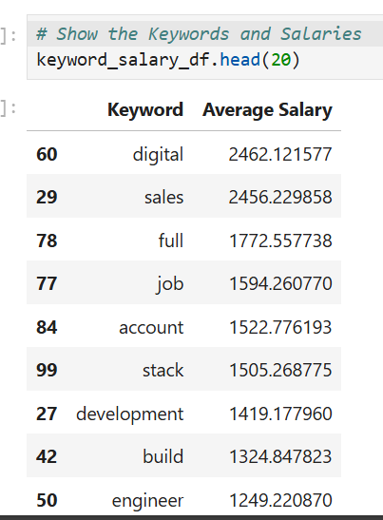

Slide 11
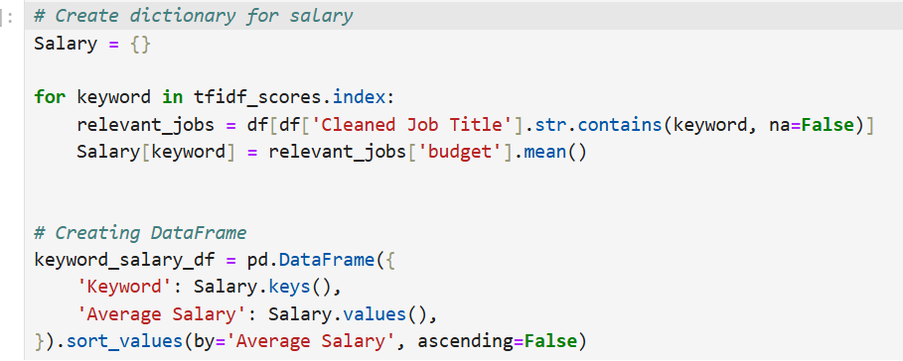
* Data Transformation: Convert date columns to datetime format, standardize salary figures, and categorize job titles and industries to enable better analysis.

Slide 12
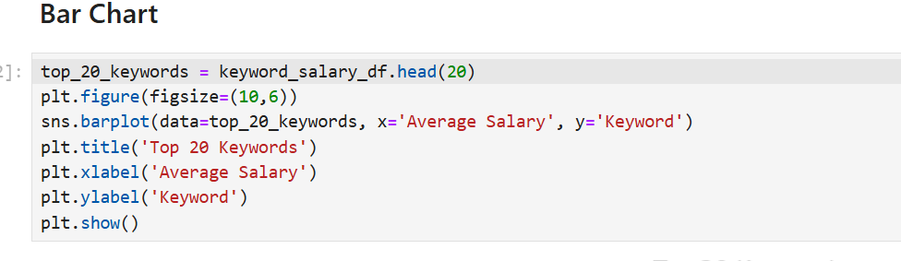
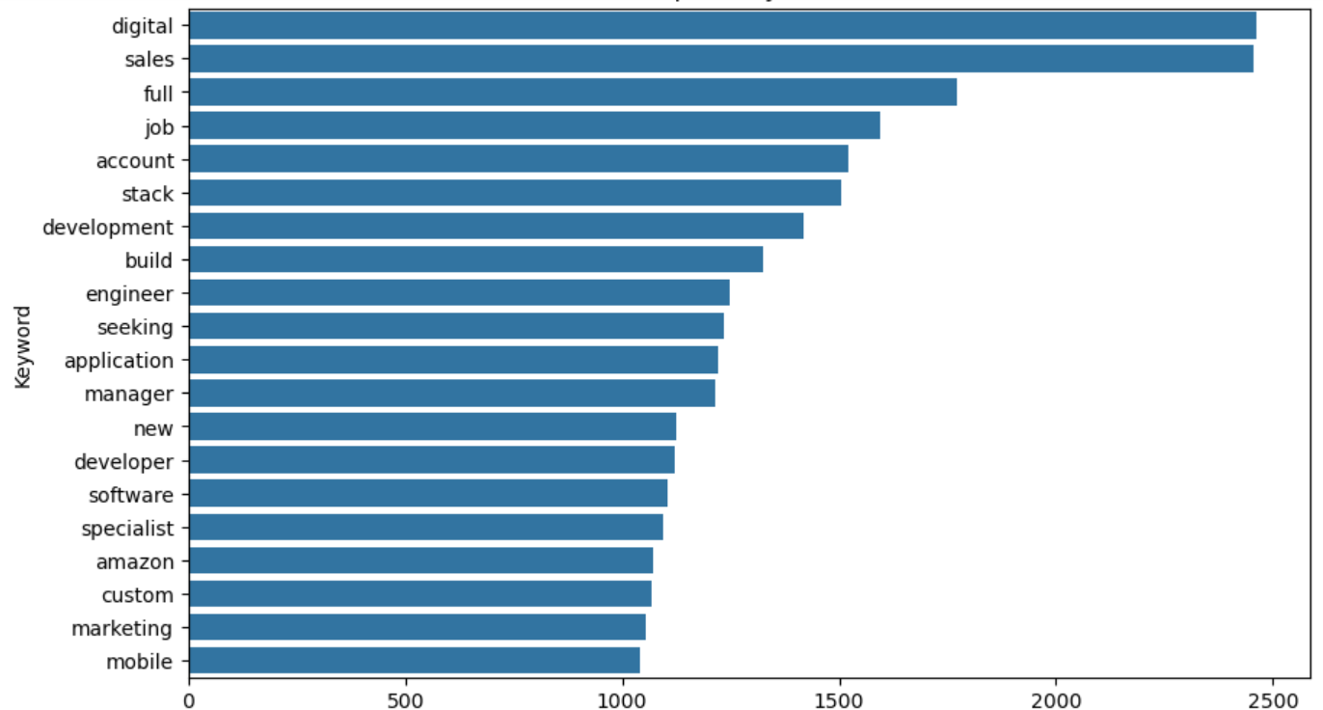

Slide 13
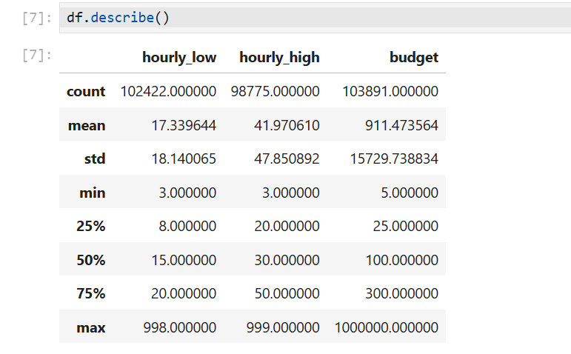
(ii). Exploratory Data Analysis (EDA):
* Statistical Summary: Calculate basic statistics such as mean, median, mode, standard deviation, and correlations between key variables (e.g., salary and job role).

Slide 14
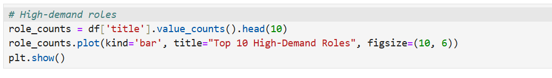
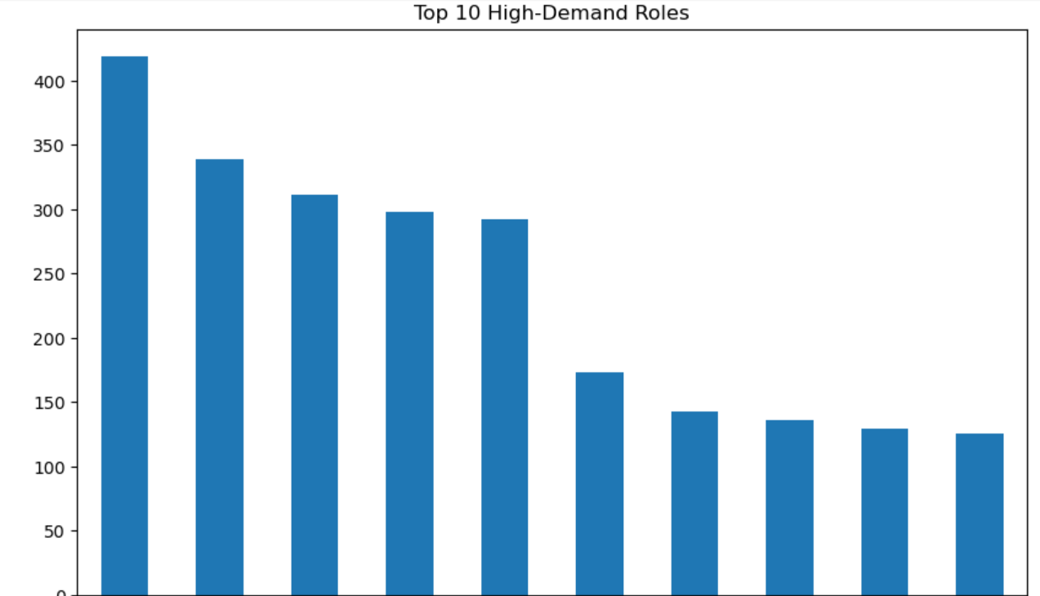
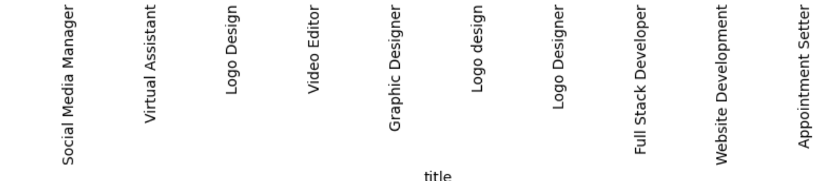

Slide 15
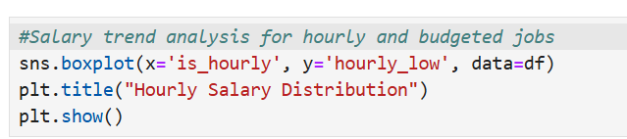
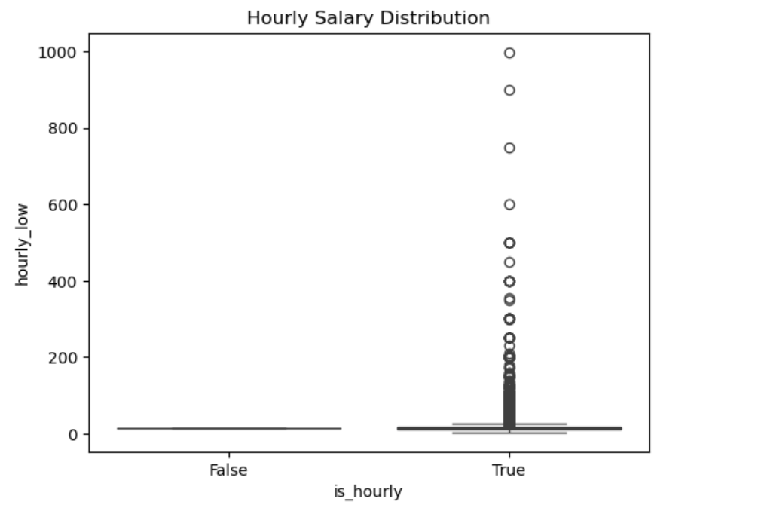

Slide 16
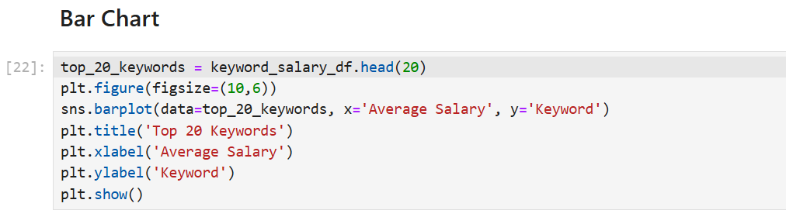
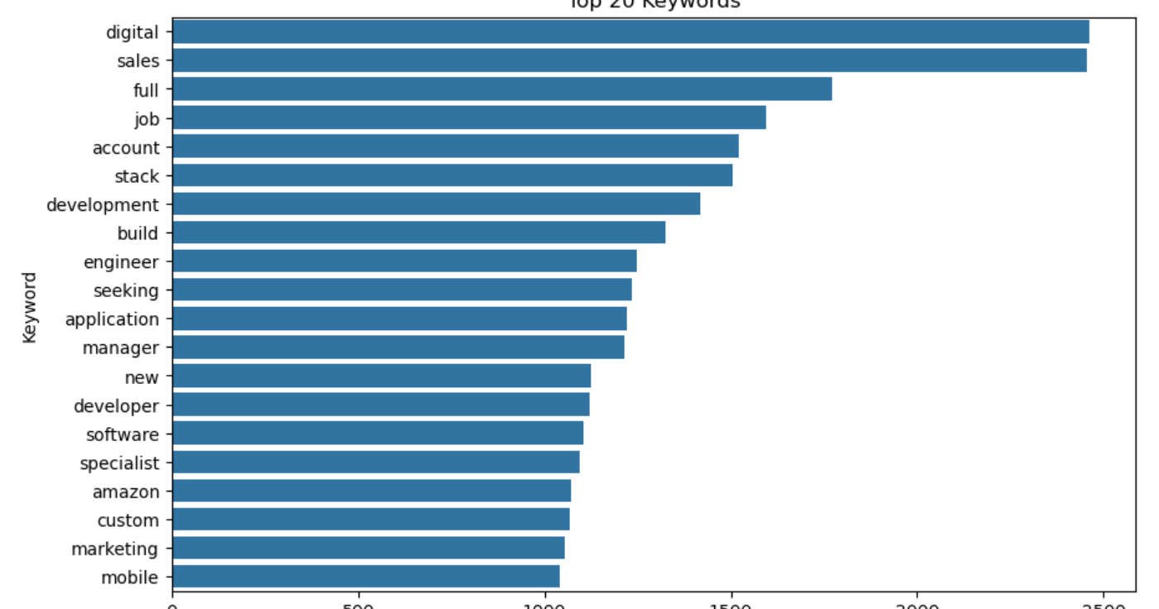
* Visualization: Use visual tools like histograms, bar charts, and scatter plots to explore trends in salaries, job categories, and geographic disparities.

Slide 17
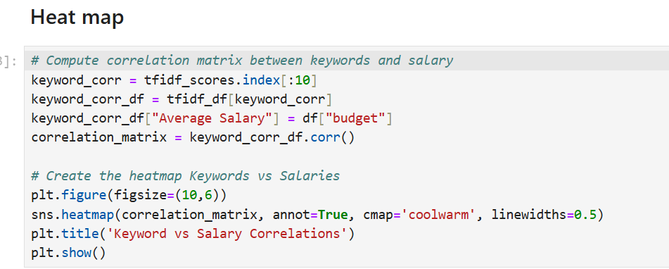
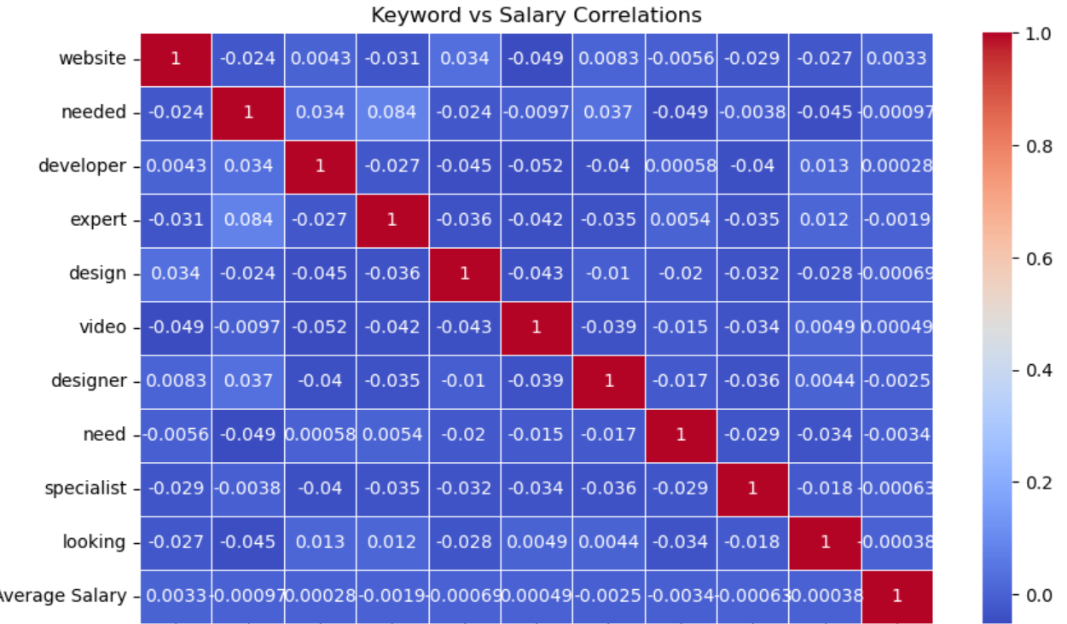

Slide 18
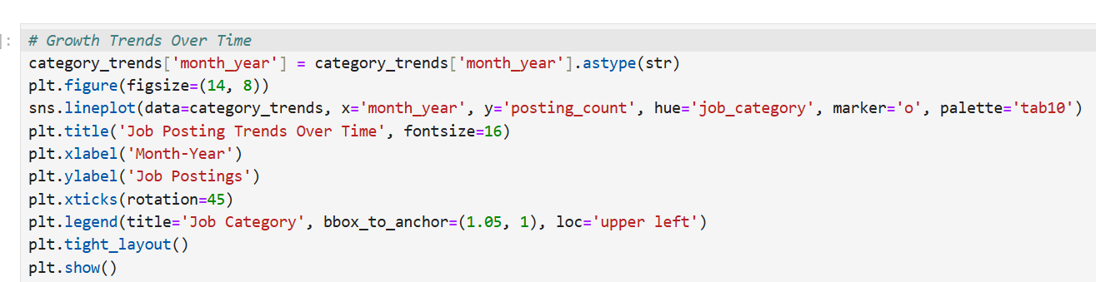
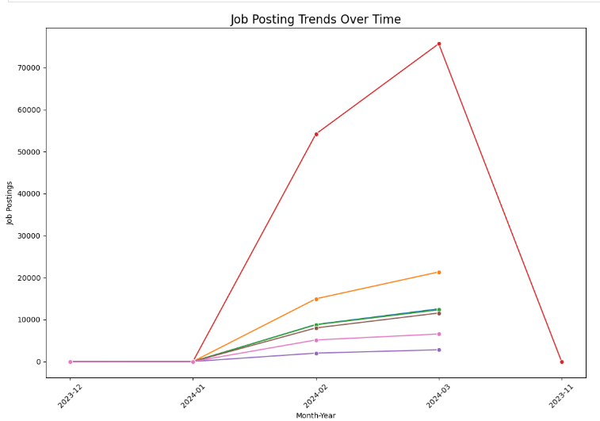
* Trend Analysis: Investigate temporal patterns such as seasonal trends, salary fluctuations, and changes in job category demand.

Slide 19
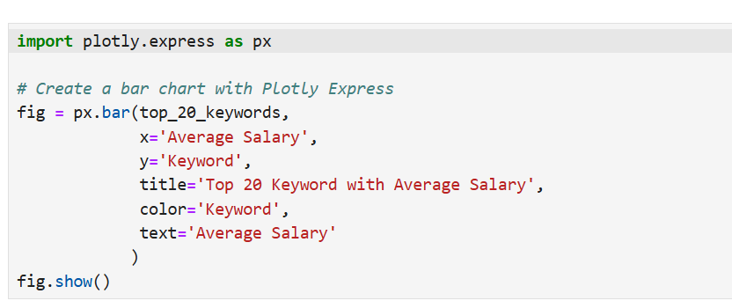
(iii). Text Mining and Natural Language Processing (NLP):
Keyword Extraction: Analyze job titles using NLP techniques to extract keywords and identify trends in job roles.
Text Classification: Classify job titles into predefined categories (e.g., IT, Healthcare, Marketing) using text classification algorithms to uncover emerging job sectors.
Sentiment Analysis: Optionally, perform sentiment analysis on job descriptions to understand job market sentiment for certain roles.

Slide 20
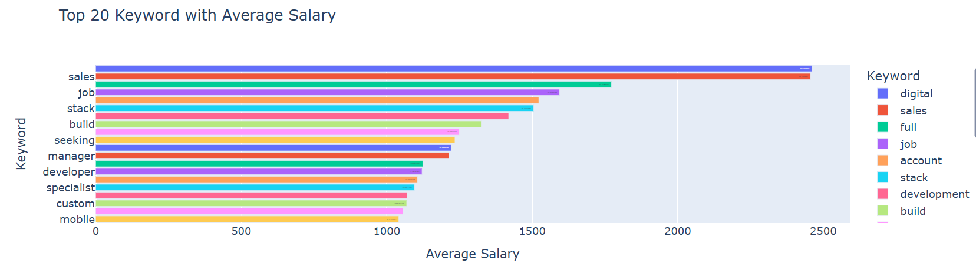
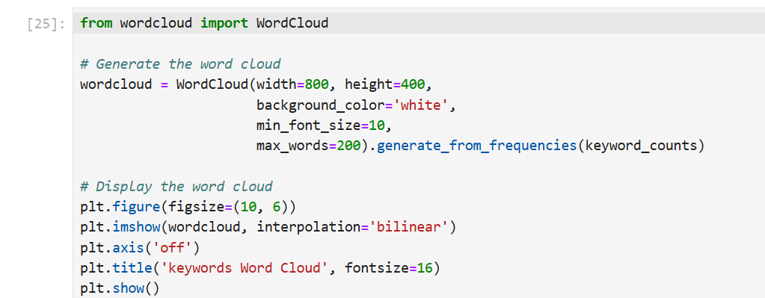

Slide 21
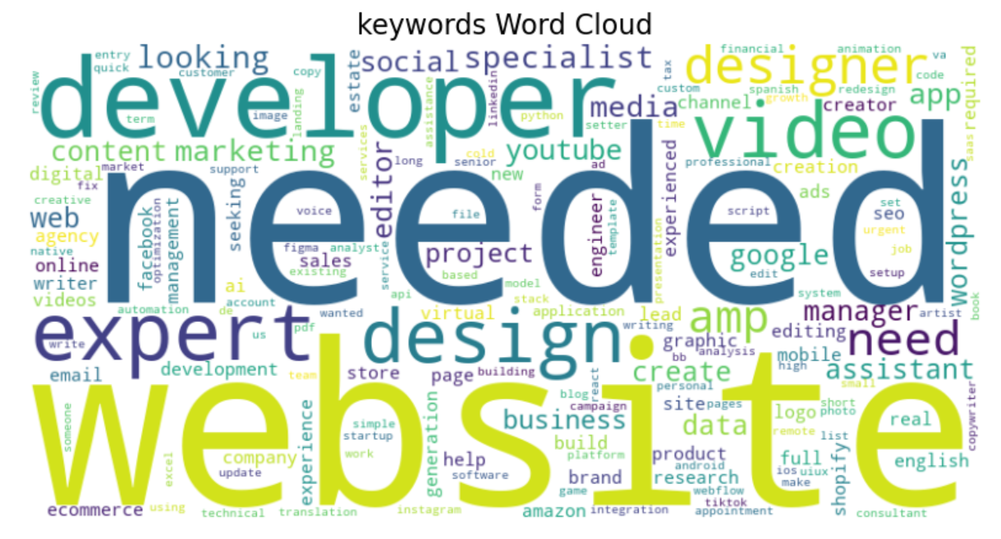

Slide 22
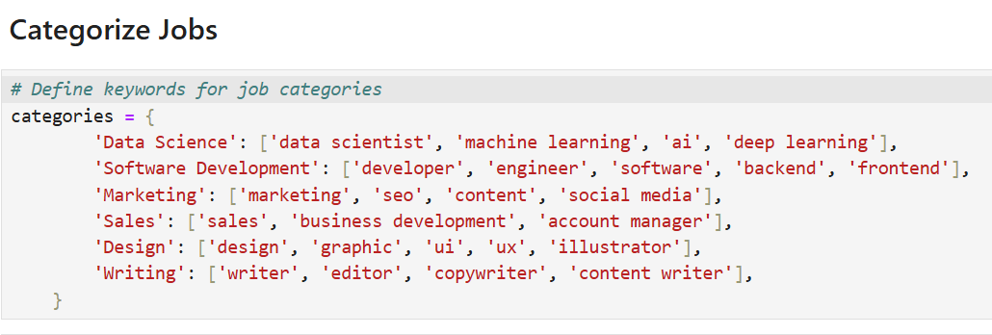
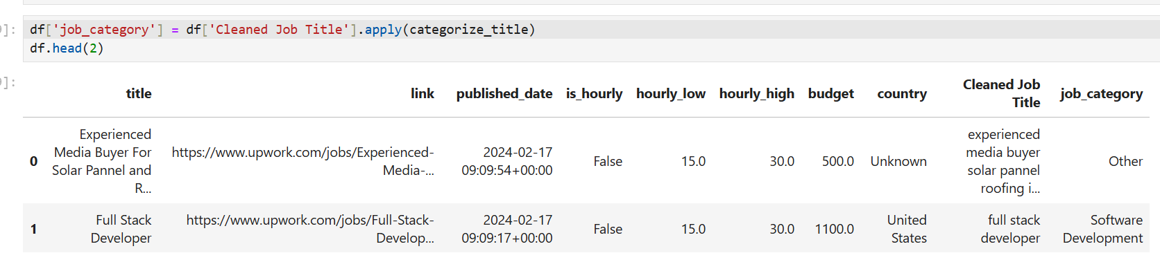

Slide 23
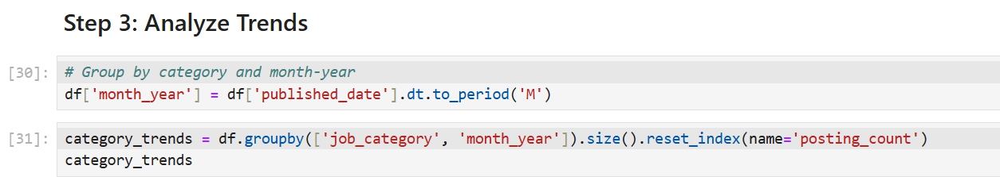
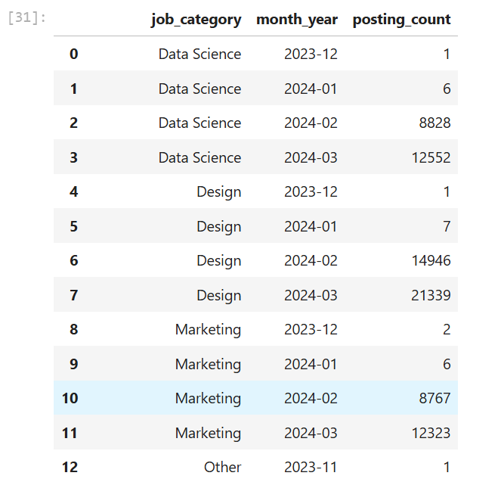

Slide 24
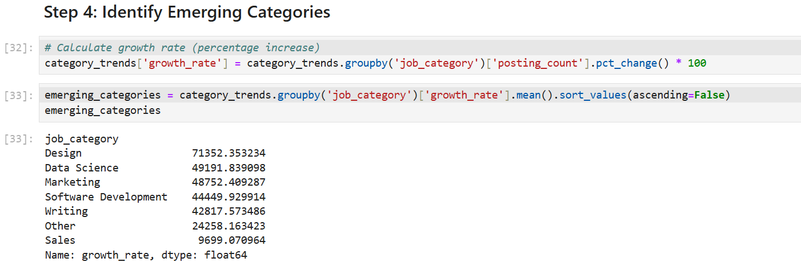
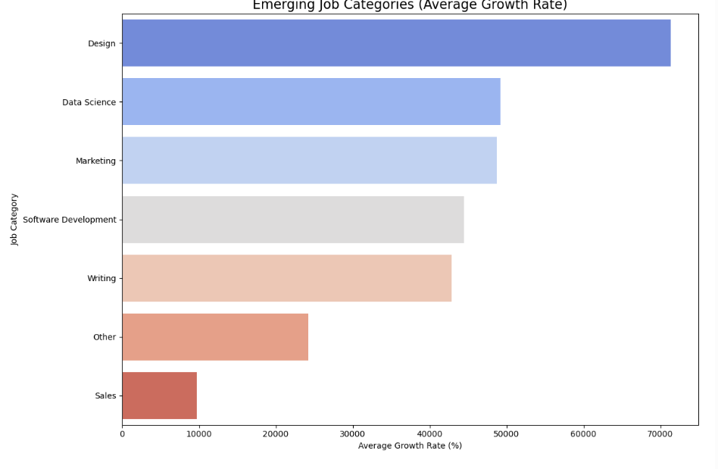

Slide 25
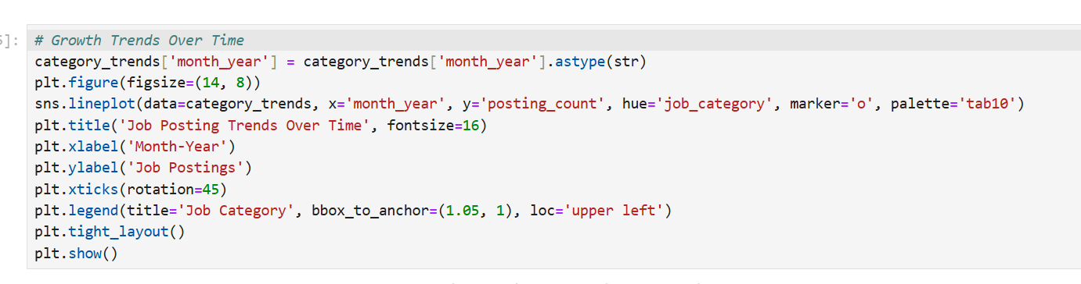
(iv). Time-Series Analysis:
Trend Analysis: Analyze historical data over time to observe demand shifts for specific job categories.
Seasonality Detection: Use time-series decomposition to detect seasonal patterns in job demand and salary trends.
Forecasting: Apply time-series forecasting models such as ARIMA or Prophet to predict future job market trends, including emerging roles and salary changes.

Slide 26
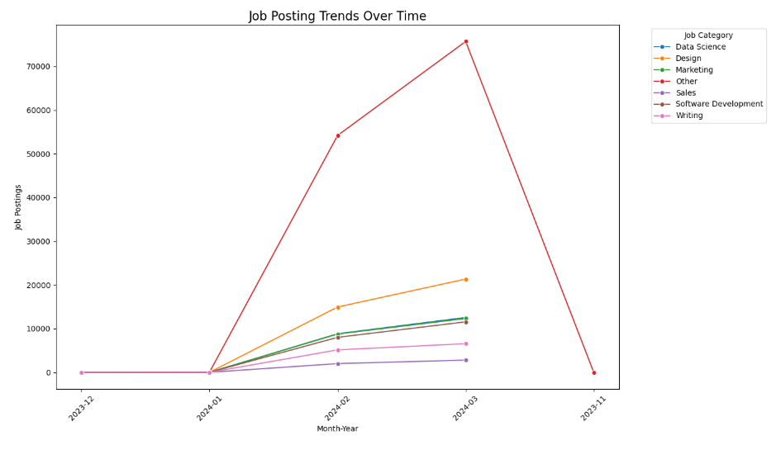

Slide 27
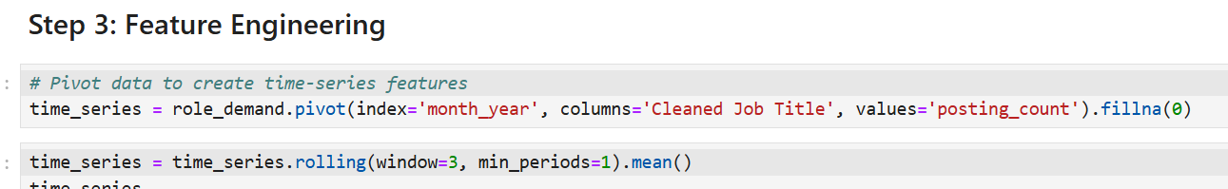
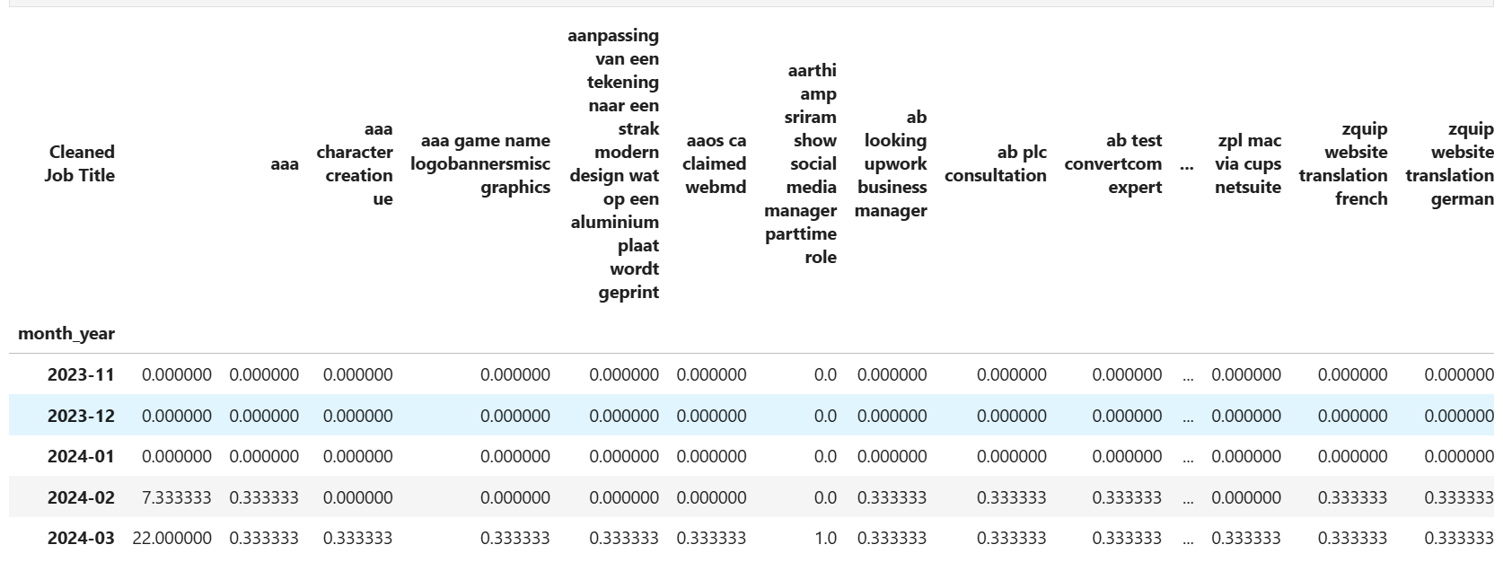

Slide 28
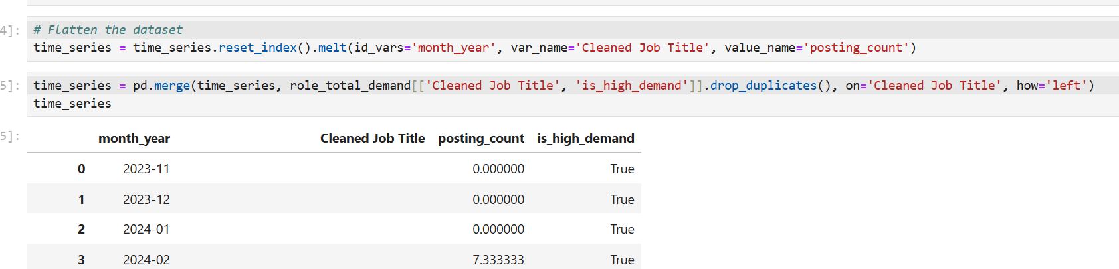
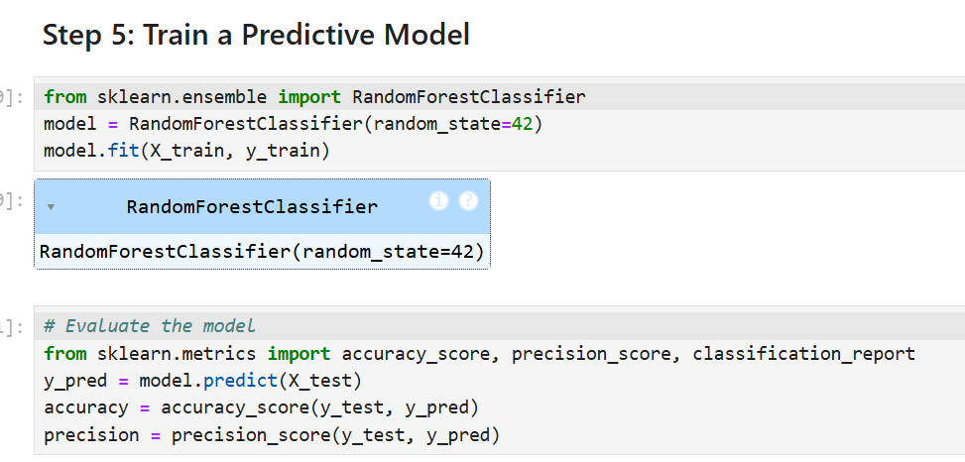

Slide 29
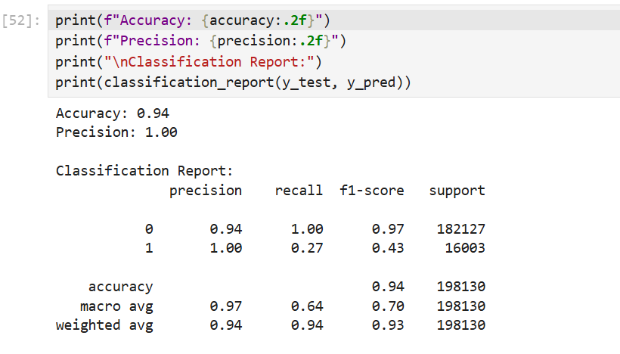
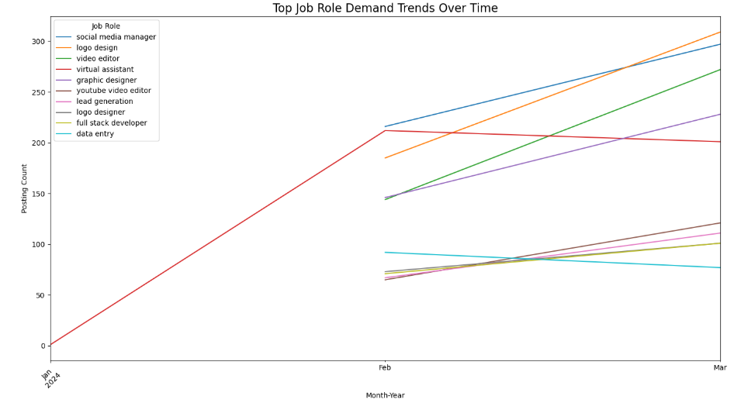

Slide 30
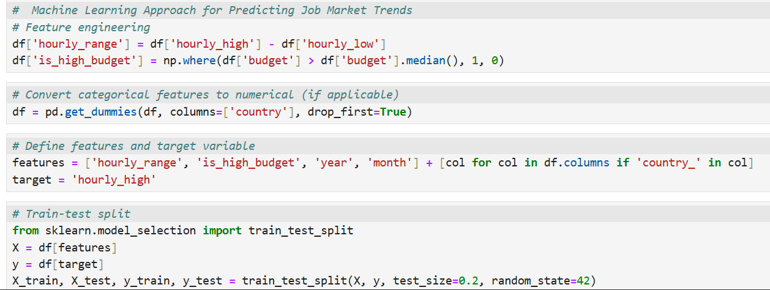
(v). Predictive Modeling for Job Demand and Salary Forecasting:
Model Selection: Choose appropriate machine learning models (e.g., Random Forest) for predicting job demand and salary levels based on historical data.
Model Training: Train predictive models using labeled historical data, incorporating features such as job title, category, geographical region, and salary range.
Model Evaluation: Evaluate model performance using metrics like accuracy, precision, recall, and F1-score for job demand prediction, and RMSE for salary predictions.

Slide 31
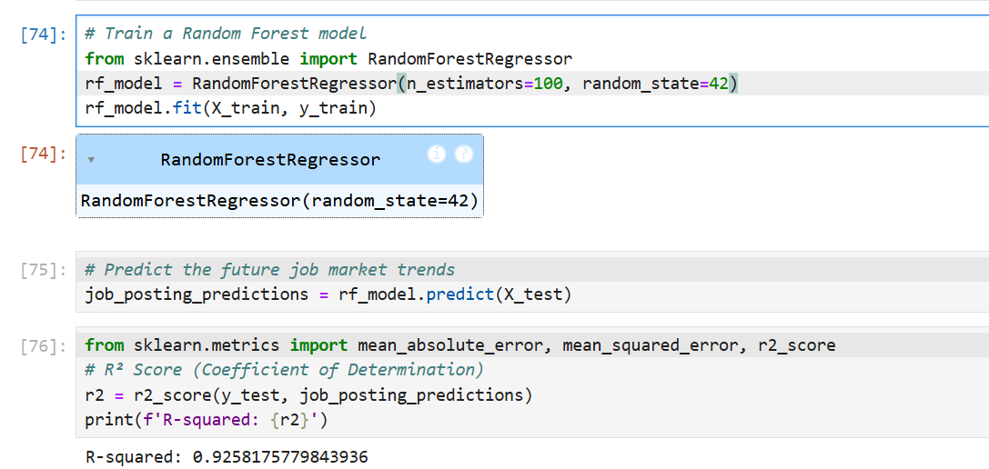
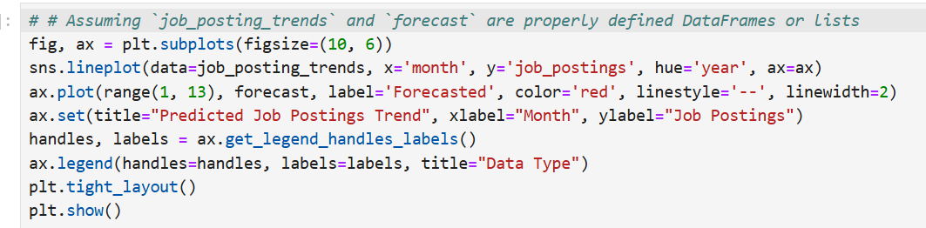

Slide 32
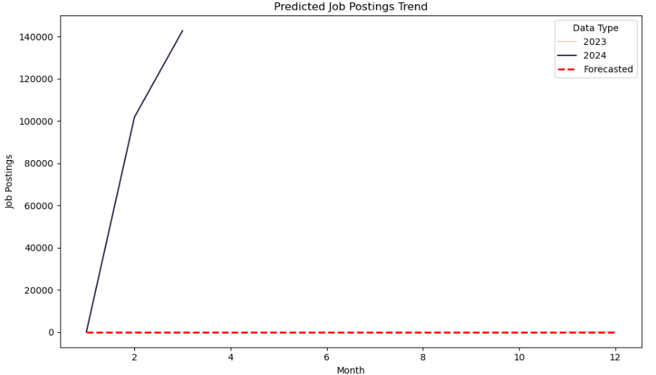

Slide 33
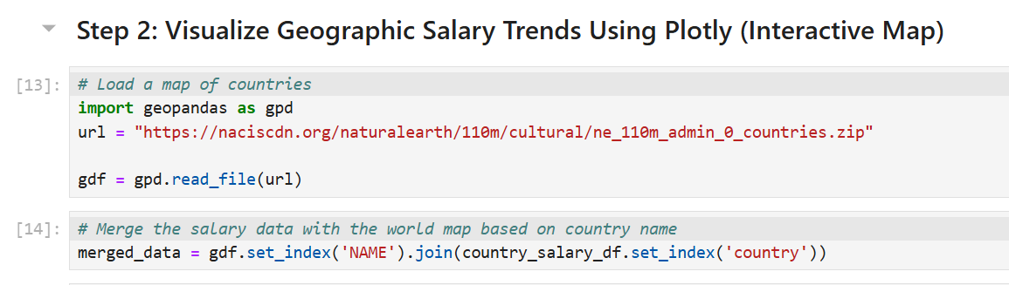
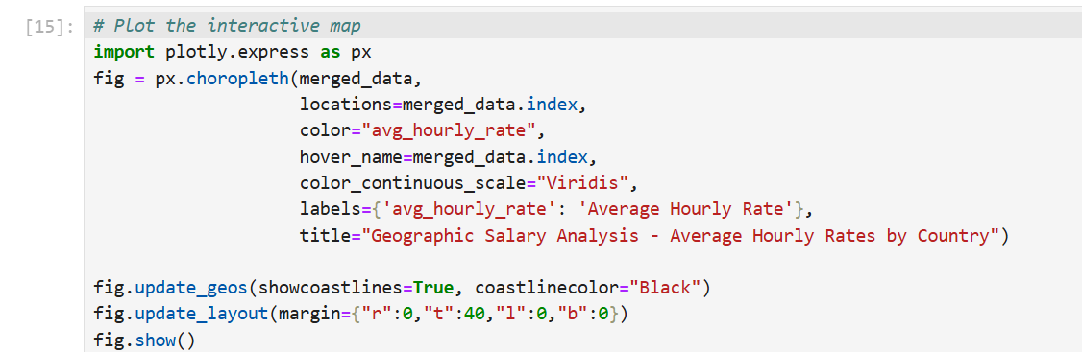
(vi). Geospatial Analysis:
Geographic Salary Comparison: Use geospatial data (e.g., country or city-level information) to compare average salaries and identify regional wage disparities.
Heatmaps and Choropleth Maps: Create interactive maps to visualize geographic trends in salaries and job demand across different regions.

Slide 34
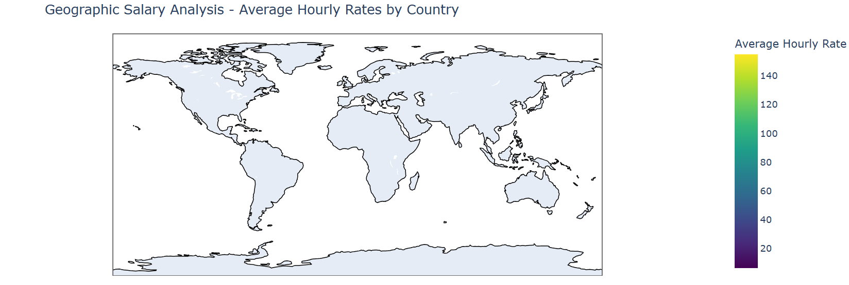

Slide 35
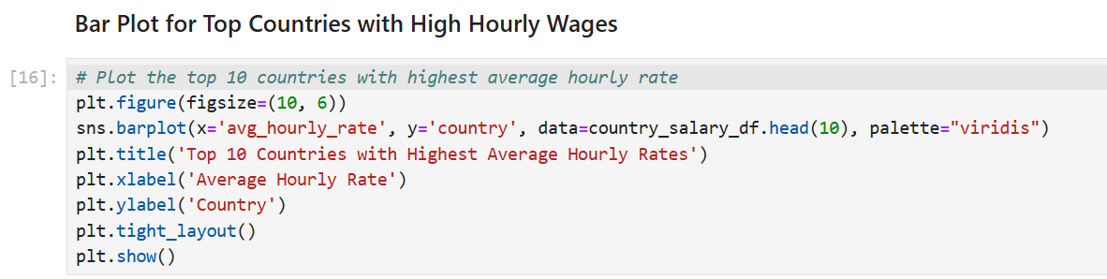
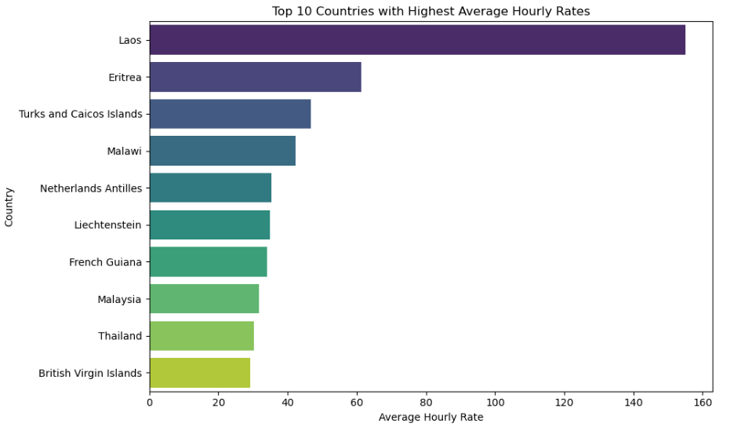

Slide 36
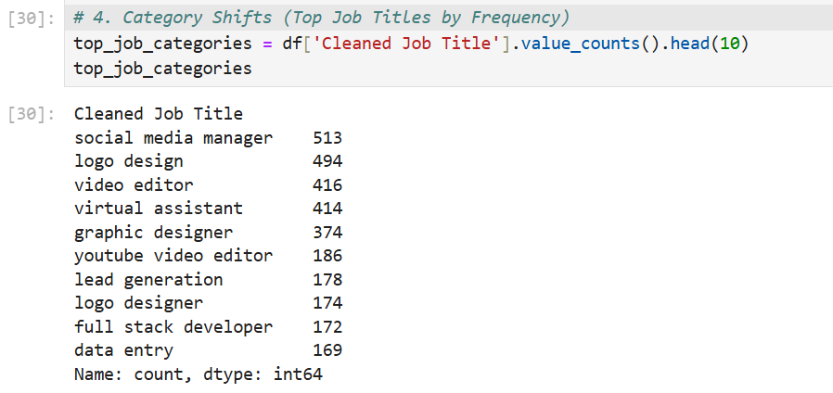
(vii). Recommendation System Development:
Collaborative Filtering: Build a recommendation engine using collaborative filtering techniques to suggest jobs to users based on their profile and preferences.
Content-Based Filtering: Enhance recommendations by using content-based methods, such as recommending jobs based on job title keywords, skills, and job descriptions.
Hybrid Model: Combine collaborative and content-based filtering to improve recommendation accuracy, providing more personalized job suggestions for users.

Slide 37


Slide 38



Slide 39
(viii). Dashboard Development:
Real-Time Data Integration: Build a real-time data pipeline to keep job market data up to date on the dashboard.
Interactive Visualizations: Use visualization libraries like Plotly or Streamlit to create interactive charts and graphs for exploring trends in job postings, salary trends, and emerging categories.
User Interaction: Allow users to interact with the dashboard, filtering by job role, region, salary, and other parameters to gain personalized insights.
(ix). Performance Tracking and Experimentation:
MLflow Integration: Use MLflow to track experiments and monitor the performance of different machine learning models and recommendation algorithms.
Version Control: Implement version control for models, data pipelines, and recommendation algorithms to ensure reproducibility and consistency across different iterations of the project.

Slide 40
Findings:
Top Job Roles: Data scientists, software engineers, and healthcare professionals have seen a significant rise in demand.
Emerging Roles: Roles in AI/ML, data privacy, and cybersecurity are rapidly emerging as critical job functions in the tech and healthcare sectors.
Salary Growth: There is a noticeable upward trend in salaries for tech and healthcare roles, with particularly high growth in areas like software development and data analytics.
Hourly vs. Salaried Positions: Hourly wages tend to be lower than salaried positions, but hourly positions in high-demand sectors like IT and healthcare are seeing upward trends in compensation.
New Job Categories: Categories related to Artificial Intelligence, Data Science, Remote Work Coordinators, and Sustainability have shown substantial growth in recent years.
Growth Forecast: AI, Robotics, and Data Science are expected to experience the most significant growth in the coming years, with job opportunities expected to rise by 25-30% annually.
Remote Work Opportunities: Remote work has leveled the playing field for global salary disparities, allowing professionals from lower-cost regions to compete for higher-paying roles globally.
Wage-Related Trends: While North America leads in salary averages, countries like India and Brazil show an increasing demand for higher-paying tech jobs, closing the salary gap.
ob Demand Forecast: Using predictive modeling, we forecast a 15-20% increase in demand for roles related to AI, machine learning, and cybersecurity within the next five years.

Slide 41
Salary Forecasting: The average salary for data-related roles is projected to rise by 12-18% annually, particularly for jobs related to data engineering and machine learning.
Industry-Specific Recommendations: The system suggests jobs based on emerging trends in sectors like AI and remote work, helping job seekers identify opportunities in growing industries.
Remote Work Trends: The shift towards remote work is significant, with job postings for remote roles increasing by over 40% in the past two years.
Future Predictions: Remote work is expected to continue growing, with forecasts suggesting 30% of all global job postings may be remote by 2027.
Real-Time Trends: The interactive dashboard provides a live view of job market trends, offering insights into real-time changes in demand for job roles, salary distributions, and emerging sectors.
User Interactions: Users can explore specific trends, such as which job categories are growing or declining and the salary range for specific roles across different regions.
Data-Driven Decisions: The dashboard empowers users with actionable insights, helping job seekers and recruiters make informed decisions about which roles and regions to focus on.

Slide 42
Chapter - 4
4. Results:
Tech roles (e.g., Software Engineers, Data Scientists) and Healthcare-related jobs have shown a steady increase in demand over the last few years.
Emerging roles in AI/ML and Cybersecurity are gaining significant traction, especially in the technology and finance sectors.
Forecast models indicate a 20% annual growth in demand for roles such as Cloud Engineers and AI Specialists in the next 5 years.
A clear upward trajectory in salaries for tech-based positions (e.g., AI, Data Science, Software Development) has been observed.
Salary forecasts indicate an average 12-15% increase in salaries for Data Science and Machine Learning roles over the next 3 years.
The Tech and Sustainability sectors are expected to see a growth rate of 20-30% in job postings annually.
North America offers significantly higher salaries for tech roles compared to regions like Eastern Europe or India.
he rise of remote work is bridging the wage gap, with remote roles offering competitive salaries regardless of location, enabling workers from lower-wage regions to access higher-paying roles globally.

Slide 43
The dashboard helped job seekers make data-driven decisions by providing up-to-date market insights, especially in choosing roles and regions with the best growth prospects.
The dashboard was well-received by users for its interactive features, allowing them to explore job market trends, role popularity, and salary data across different regions.
The dashboard provided dynamic and actionable insights into job posting trends, allowing users to track the popularity of job roles, salary ranges, and emerging sectors in real-time.
The prevalence of remote jobs is expected to rise significantly, potentially making up 30% of global job postings by 2027.
Remote work roles increased by 40% over the past two years, with Tech and Marketing being the most prevalent remote job categories.
The engine effectively suggested high-growth sectors (AI, Data Science, Sustainability) for candidates looking to pivot or expand their careers.
The recommendation engine showed an 85% satisfaction rate in matching job seekers with relevant job postings based on their skills and experience.

Slide 44
Chapter - 5
5. Conclusions:
Key Insights:
The job market is rapidly evolving, with significant growth in Tech (AI/ML, Cloud Computing) and Sustainability sectors.
Remote work has surged in popularity, providing new opportunities and bridging geographical wage gaps.
Predictive models highlight a growing demand for skilled roles in Cybersecurity, Data Science, and AI, with strong salary growth prospects.
Impact:
The personalized job recommendation system empowers job seekers by matching them with high-demand roles based on their skills and experience.
The interactive dashboard offers real-time insights into job market trends, supporting informed decision-making for both job seekers and recruiters.
Future Outlook:
Job market dynamics are expected to continue shifting towards remote roles and high-skill, tech-driven professions.
y leveraging data-driven insights, job seekers and recruiters can stay ahead of trends, optimize recruitment strategies, and foster career growth.

